Slide 1
SHOP IT STORE ANALYSIS
Analyst: Musayayi Precious.I
Tools: MS Excel
Date: 18/02/2026

Slide 2

Business Problem
Shop It Store is an online fashion store that sells fashion items worldwide across different platforms. The main problem is that the store has difficulty tracking user behavior and understanding how customers interact with its products.
The goal is to analyze user behavior, product performance across different platforms, customer satisfaction levels, and to identify which product is the best seller.

Slide 3

Data Overview
Data source: https://chandoo.org/wp/wp-content/uploads/2025/11/ecommerce-blank.xlsx
It includes variable such as TX id, Product, Quantity, Unit price, Order date, ship date, customer gender, order mode, Rating, state, country, days to deliver, Weeknum.

Slide 4

Key findings
The store recorded a total of 2,400 orders within three months (January–March).
Customers gave an average rating of 4.0, and the average delivery time for products is 2 days.
The total sales generated across different platforms within the three month period amounted to $649,020 , with the app recording the highest sales of $229,394.
A total of 11,997 items were sold across all platforms, and the app had the highest quantity sold, with 4,220 items.
Regarding customer demographics, 55% of customers are female, 39% are male, while 9% did not specify their gender.

Slide 5

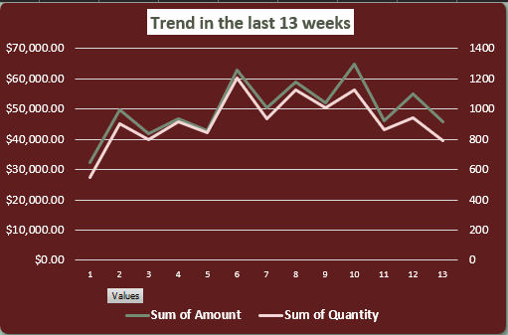
Key Findings
Week 10 recorded the highest sales, totaling $64,915.70, while Week 1 had the lowest sales at $32,413.30.
In terms of quantity sold, Week 6 had the highest number of items sold (1,202 units), whereas Week 1 recorded the lowest quantity (546 units).
Female customers tended to shop more in Week 6, generating sales of $39,327.40 and purchasing a total quantity of 725 items. Male customers showed higher purchasing activity in Week 8.
Customers identified as other or unspecified genders recorded their highest sales in Week 10, with total sales of $11,969 and a quantity of 164 items sold.

Slide 6
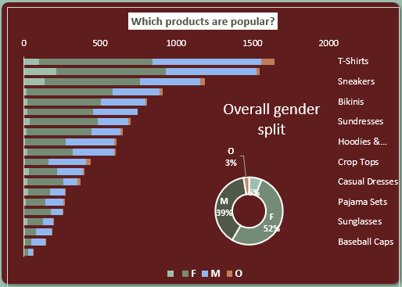

Key Findings
T-shirts, sneakers and bikinis are the top items that are sold.
The highest item bought by females are T-shirt, sneakers and bikini of 744, 761, 627 respectively and the least is baseball cap
And the highest item bought by male are T-shirt, sneakers and tank top 713, 598, 393 and the least of it is sunglasses
Others and unidentified genders mostly buy jeans, sneakers and casual dresses.

Slide 7
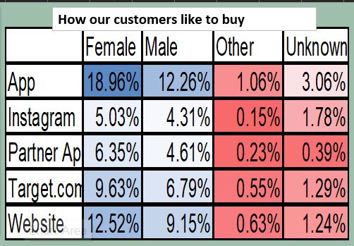

Key Findings
Female customers make most of their purchases through the app, accounting for 18% of total sales, while male customers purchase more through the website, contributing 12%.
Customers identified as other or unspecified genders also make most of their purchases through the app.
Female customers are the highest users of Target.com and the partner app, contributing 9.65% and 6.35% respectively.

Slide 8

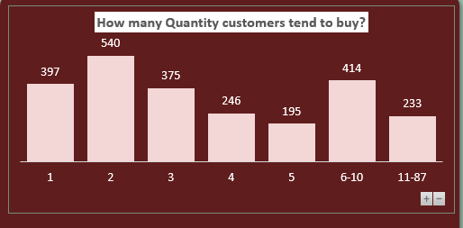

Key Findings
Customers tend to purchase two items at a time, with 540 orders buying a quantity of two per order. The second highest purchase category is 6–10 items per order, with 414 orders.
Female customers are more likely to purchase higher quantities, particularly from six items and above.

Slide 9

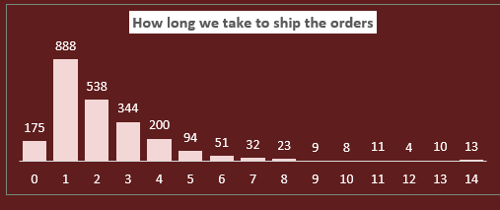
Key findings
Day 1 delivery recorded the highest number of orders, with 888 orders delivered within one day.
Female customers had the highest number of one day deliveries.
The app platform has the fastest average delivery time compared to the other platforms .

Slide 10
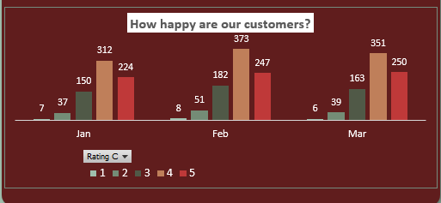

Key Findings
Throughout the three month period, 4-star ratings were the most common, while only a few customers gave 1-star ratings.
The highest number of 1-star ratings was recorded in March.
February had the highest number of positive reviews, with 373 orders receiving 4 stars and 247 orders receiving 5 stars.
Female customers gave the highest number of positive reviews in February, with 204 orders receiving 4 stars and 120 orders receiving 5 stars.
Male customers gave their highest number of positive reviews in March, with 153 orders receiving 4 stars and 106 orders receiving 5 stars.

Slide 11
Recommendation
Based on the findings, the store should focus more on strengthening the app platform, as it generates the highest sales, highest quantity sold, and fastest delivery times. Investing in app marketing, user experience improvement, and exclusive app discounts could further increase revenue.
Since female customers represent the majority of buyers and tend to purchase higher quantities, the store should design targeted marketing campaigns, bundle offers, and loyalty programs specifically for female customers to encourage repeat purchases. At the same time, strategies should be developed to increase male customer engagement, particularly on the website.

Slide 12
Recommendation
Customer satisfaction levels were strong, with an average rating of 4.0. Four-star ratings were the most common throughout the three months, and February recorded the highest number of positive reviews. Delivery performance was efficient, with an average delivery time of two days, and 888 orders delivered within one day and the fastest deliveries occurring through the app platform.
Overall, the analysis shows strong performance across platforms, high customer satisfaction, and the app emerging as the most effective sales and delivery channel.

